Slide 1
Advanced Leopard Seal Recognition System (ALSRS): Sprint 0
Bryce Robinson, Carson Buntin, Carsyn Smeda, Nathan Hontz, Juncheng Li, Ryan Huntington
Notes:
This is our sprint 0 demo of our advanced leopard seal recognition system

Slide 2
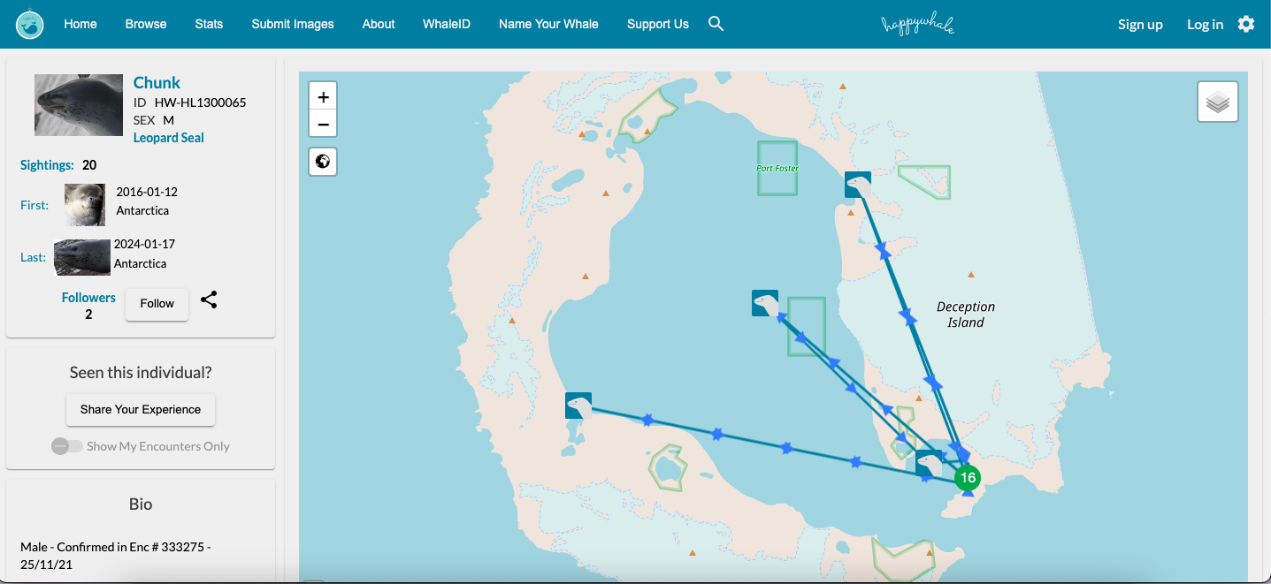
Happywhale.com
Users can upload pictures of marine wildlife
Experts identify the species in the pictures
Specific animals can be identified and tracked
Goal: automate this process, similar to their efforts with whale recognition
Notes:
Carsyn
This website, happywhale.com, is a website where users can upload pictures of marine wildlife, such as seals, sea lions, and whales, and experts can identify the species in the images. With enough pictures and encounters of a certain animal, for example the leopard seal in the image, they can be given and ID and tracked on where they go and generally when. The process for identifying specific leopard seals is manual as of now, but the goal of our project is to automate this process of recognizing specific leopard seals from pictures submitted by users to happywhale. Happywhale has capabilities to identify whales by images of their tail, so we’re trying to do a similar process but for specifically leopard seals.

Slide 3
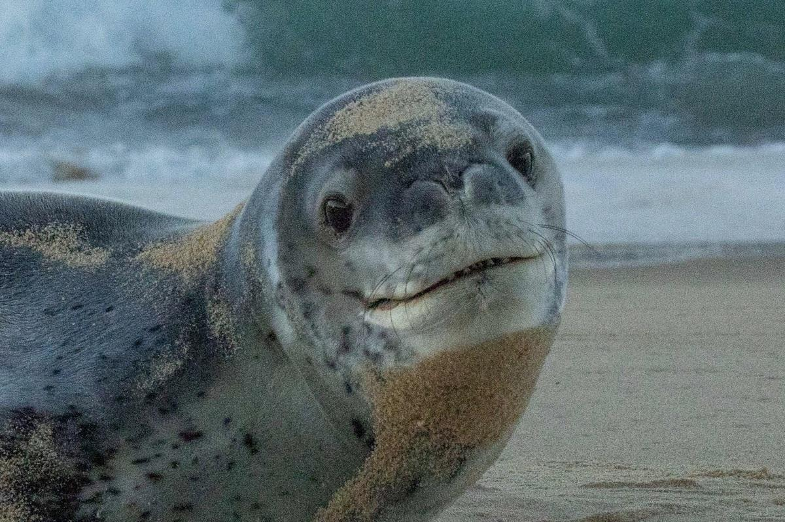
Project Overview
Current lack of effective tools to detect and identify individual leopard seals
API capable of receiving leopard seal photographs and returning the identity of any recognized seals
Happywhale should be able to make API calls to utilize our models
Two comparative machine learning models
Notes:
Carson

Slide 4
2 Comparative Machine Learning Models
Detection Model
Detect and segment seals within images
“Is this a leopard seal?”
Feed the cropped images of seals to identification model
Compete with YOLO machine learning model
Identification Model
Identify individual seals
“What leopard seal is this?”
Compete with ViT machine learning model
Notes:
Juncheng

Slide 5
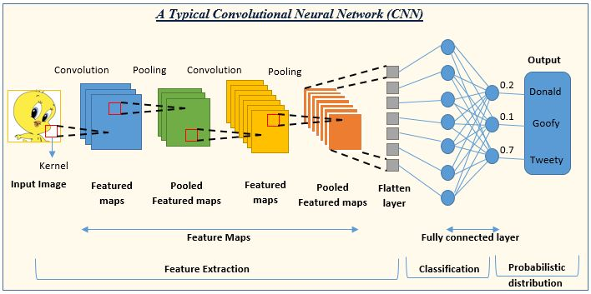
Convolutional Neural Networks
Special class of deep neural networks designed for processing structured grid data such as images
Consist of convolutional, pooling, and fully connected layers
Primarily used for feature extraction
Notes:
So just to give you guys a little overview of the type of models we'll be working on, I was going to introduce convolutional neural networks. These are a specialized type of deep neural networks, and their main use is processing grid data such as images. The main difference between Convolutional and deep neural networks are the type of layers they have, and CNN's are primarily used for feature extraction, which when talking about images this means lines, edges, etc.

Slide 6
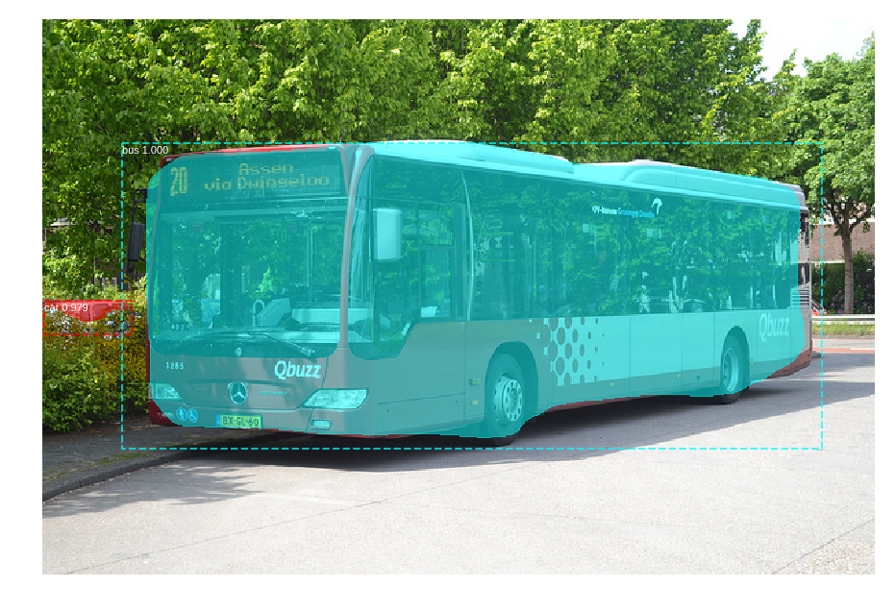
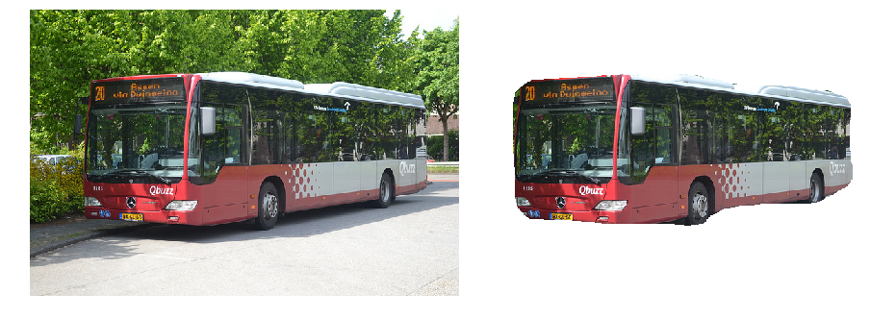
R-CNN, Faster R-CNN
Region-based Convolutional Neural Network
CNN specialized for object detection
Initial test using tensorflow and keras libraries
Notes:
Nathan, Juncheng
So our first crack at a model to compete with yolo was a couple different variations of an R-CNN, which is a region based convolutional neural network. It is essentially a CNN specialized for object detection and segmentation. Our initial test used the tensorflow and keras libraries which include a robust framework for creating neural networks. These images to the side were generated using a toy dataset, but they are the goal of what we're going for when we eventually train the model on our seal dataset. These cropped images will eventually be sent to the second model for classification.

Slide 7
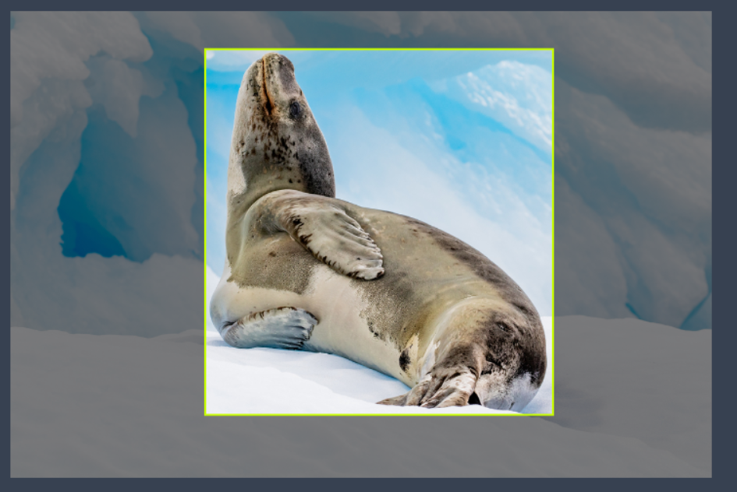
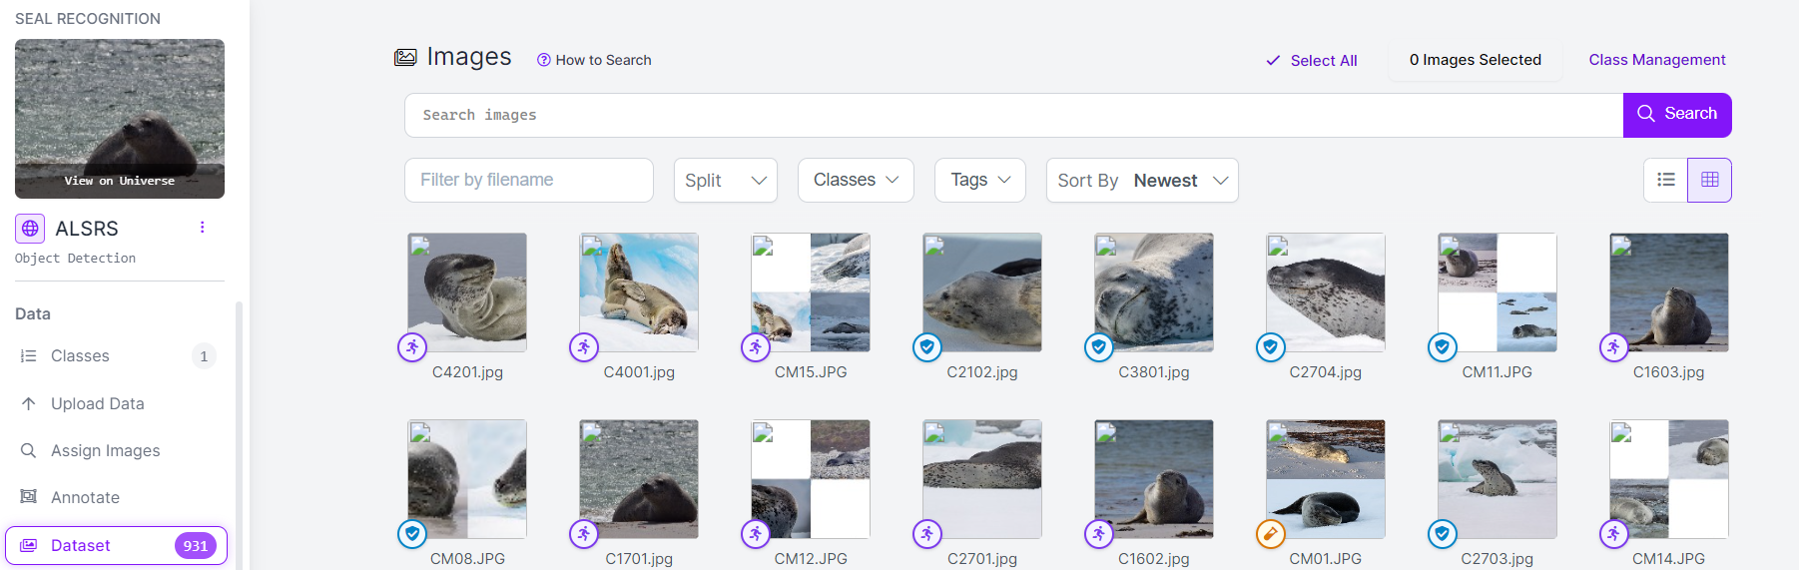
Generation of Dataset
Collect images of leopard seals and non-leopard seals
Draw bounding boxes around any and all leopard seals
Notes:
Bryce

Slide 8
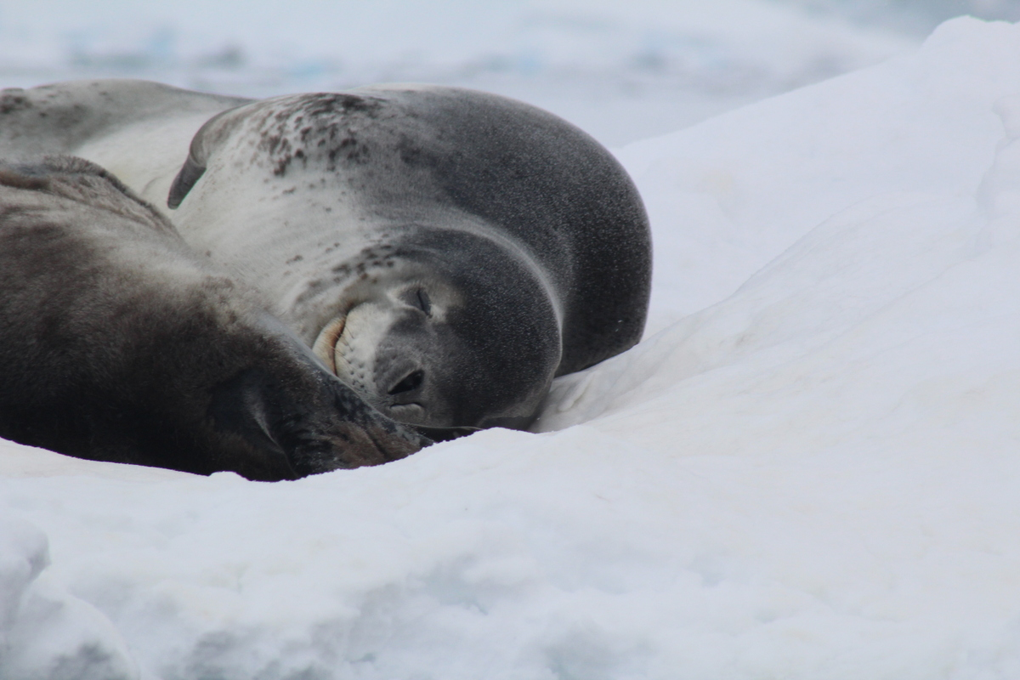
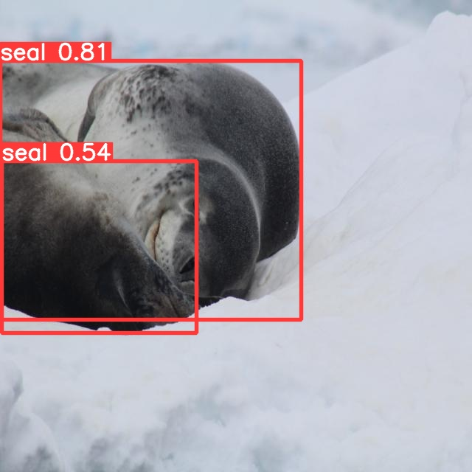
YOLO
Our baseline for Seal Detection
Notes:
Ryan

Slide 9
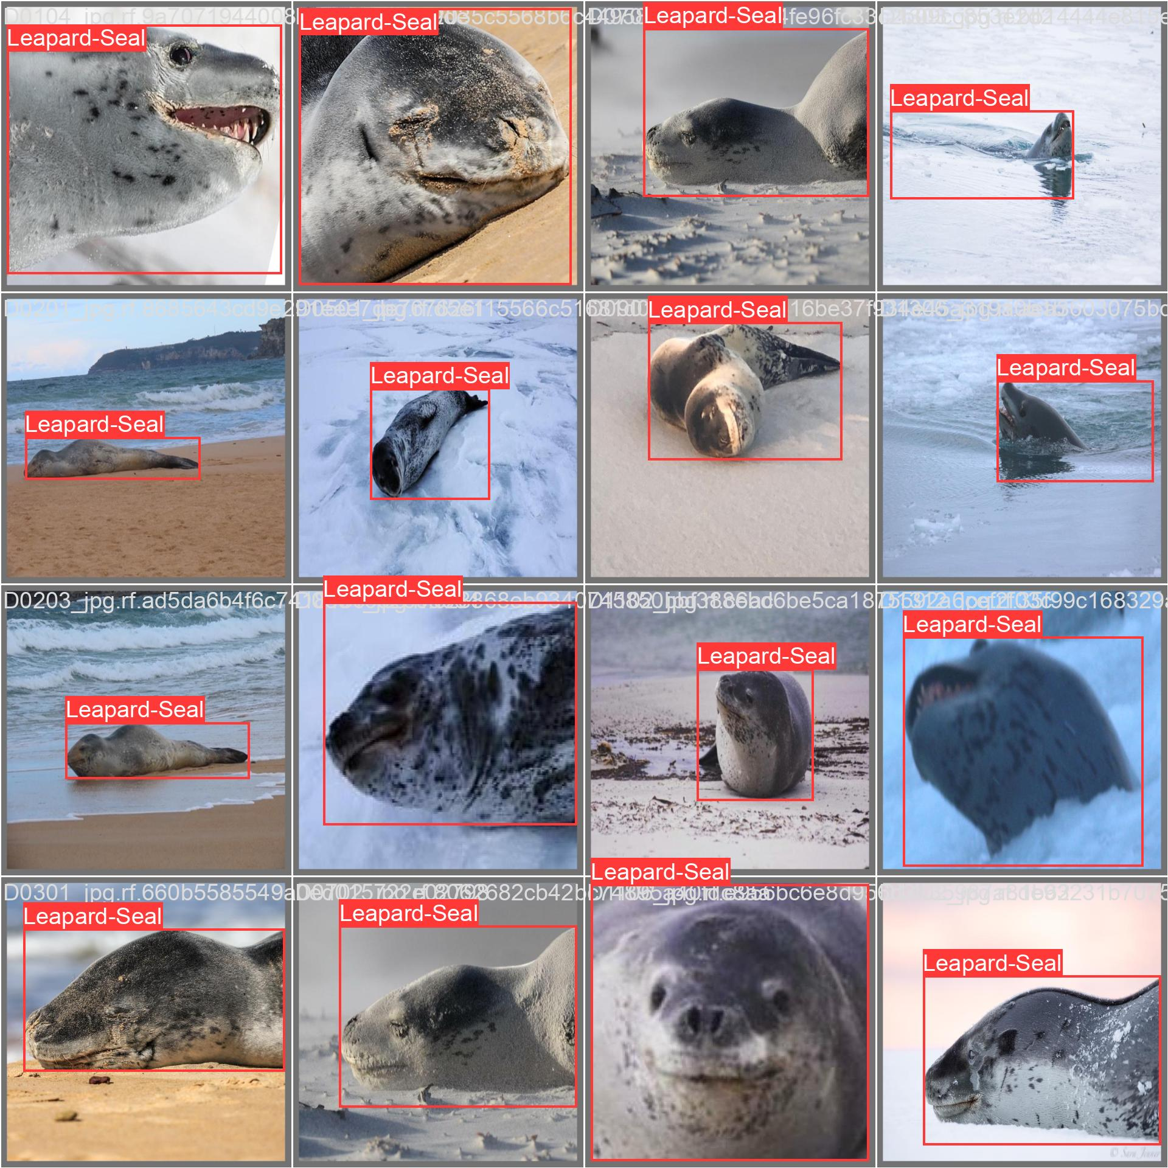
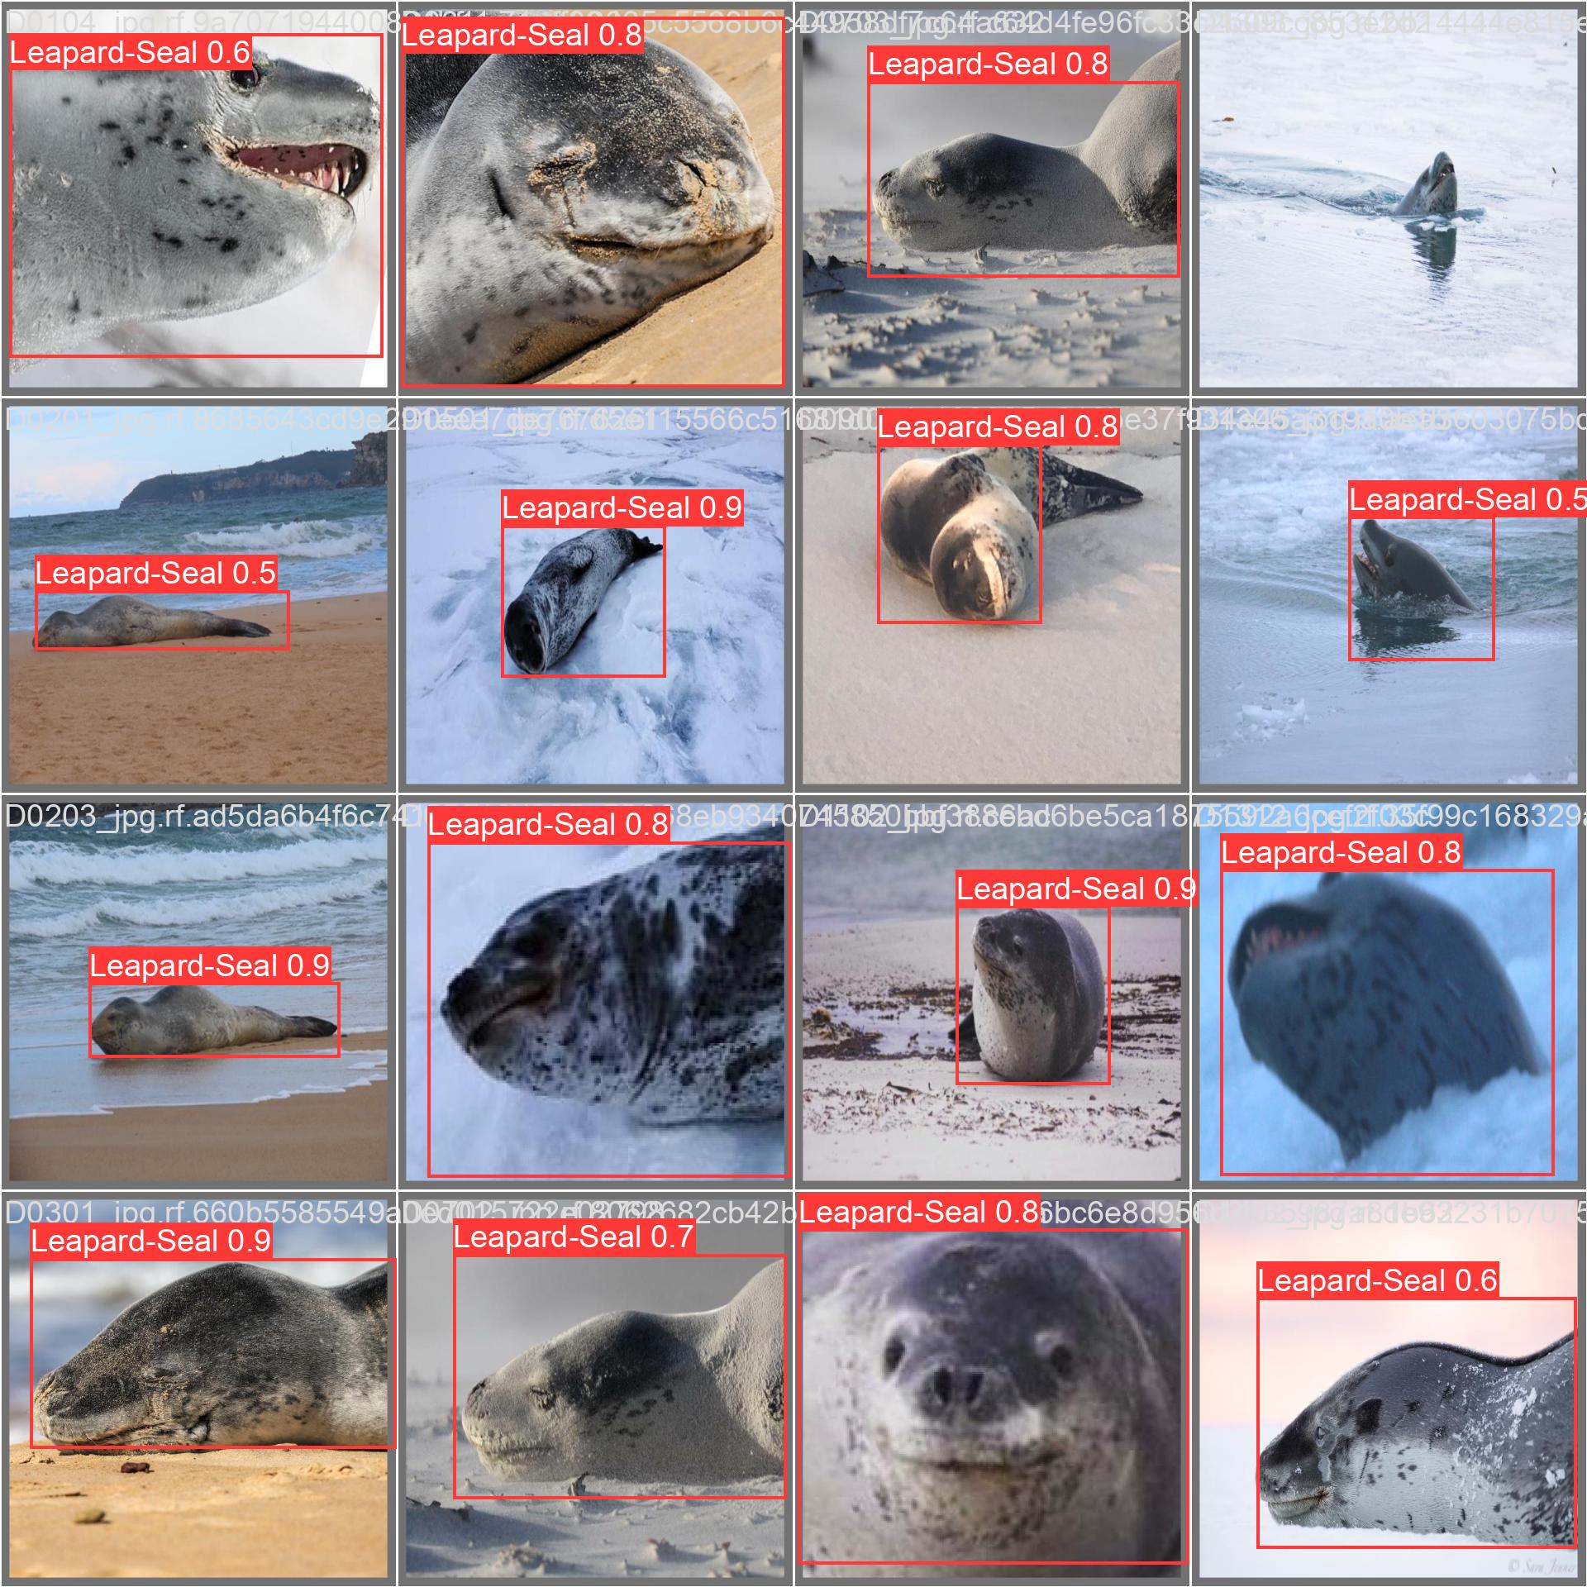
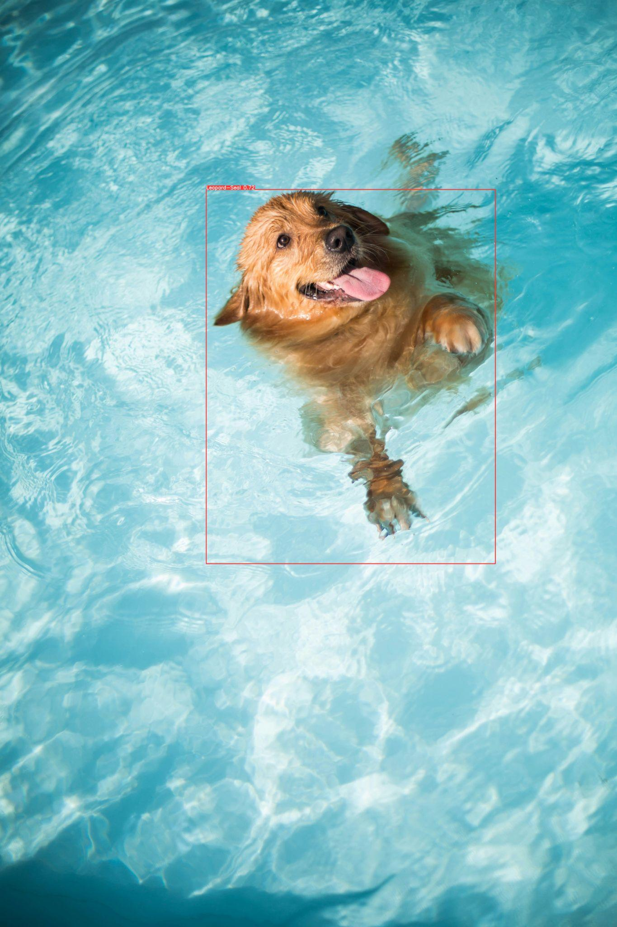
Initial YOLO Performance
Labels
Predicted
Shortcomings
Notes:
Ryan

Slide 10
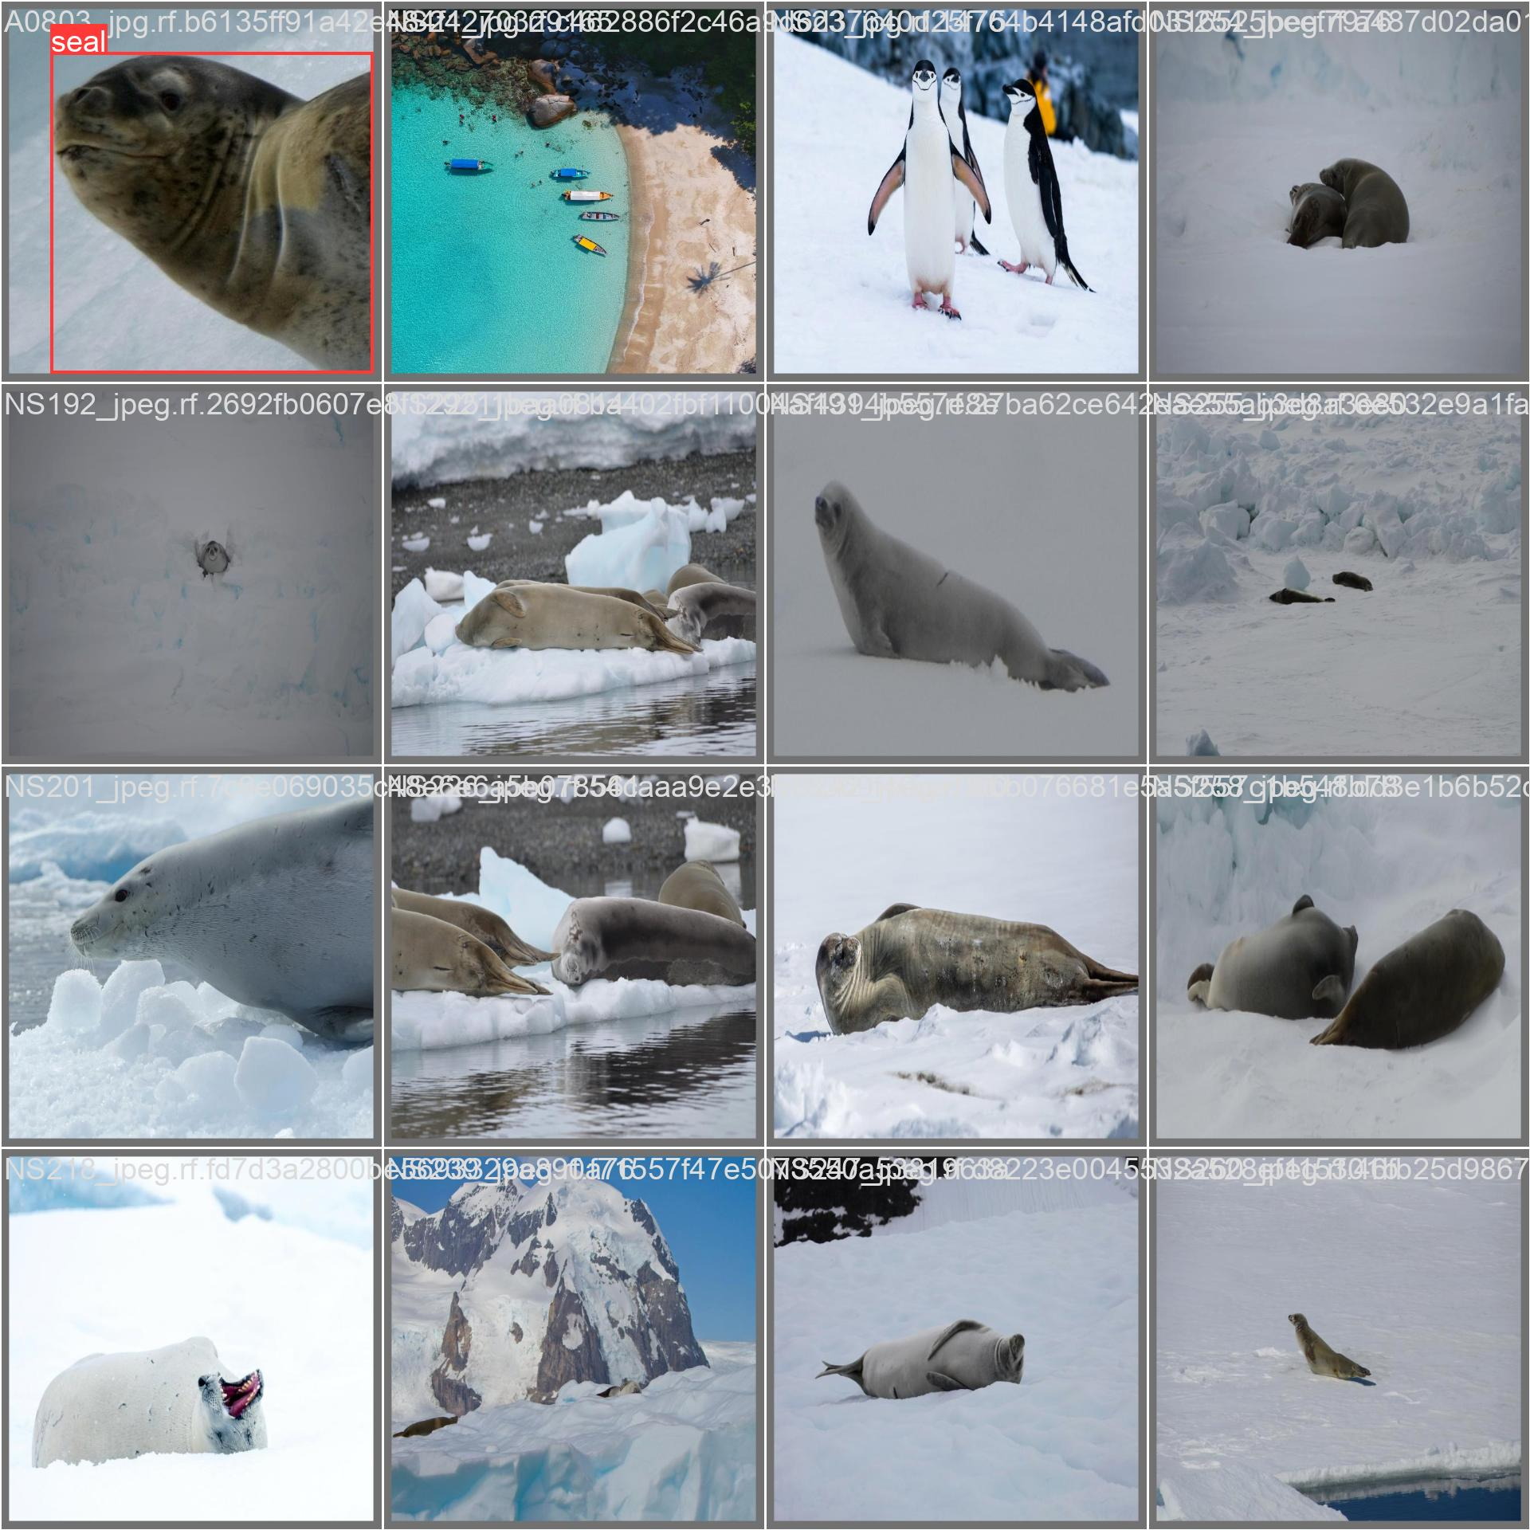
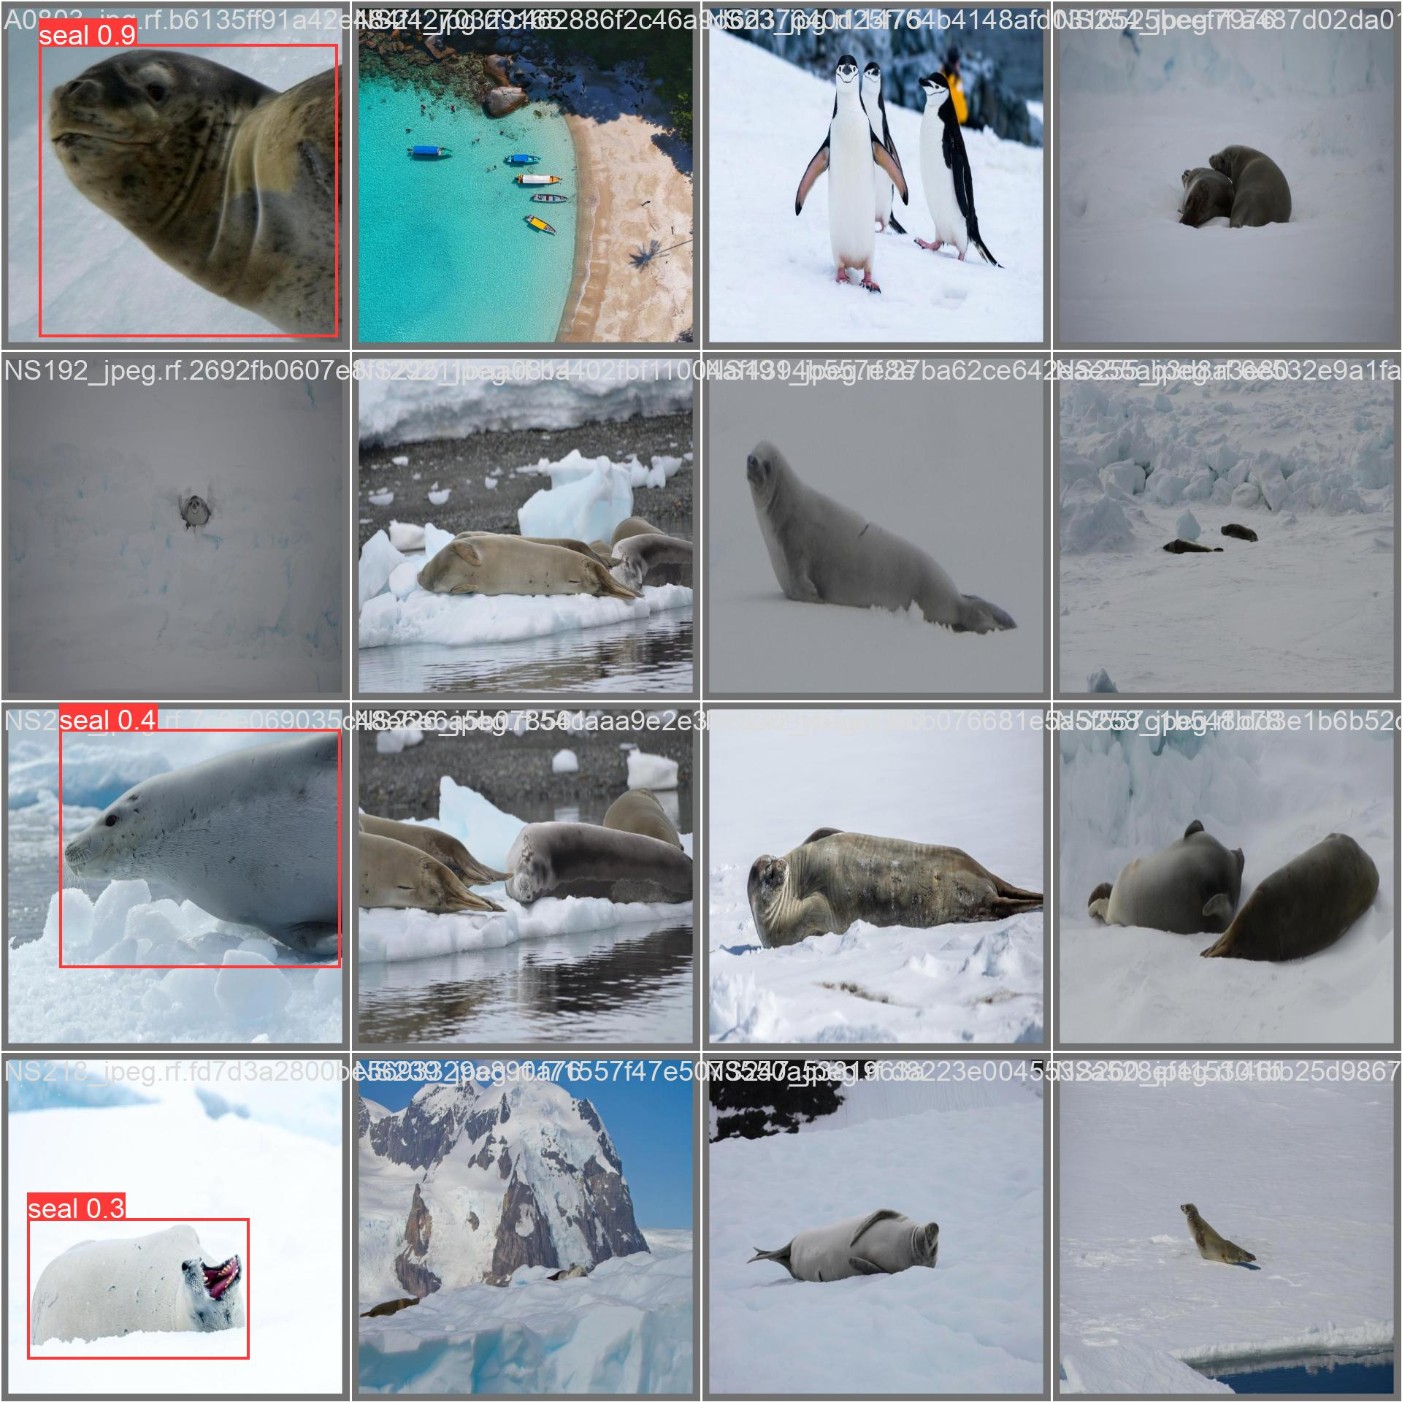
Most Recent YOLO Test
Labels
Predicted
Notes:
Ryan

Slide 11
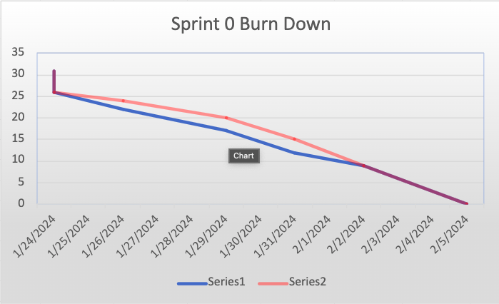
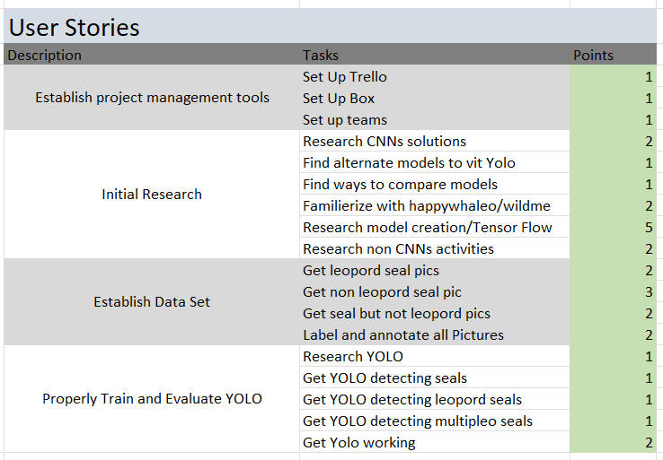
Burndown Chart and User Stories
Notes:
Carson

Slide 12
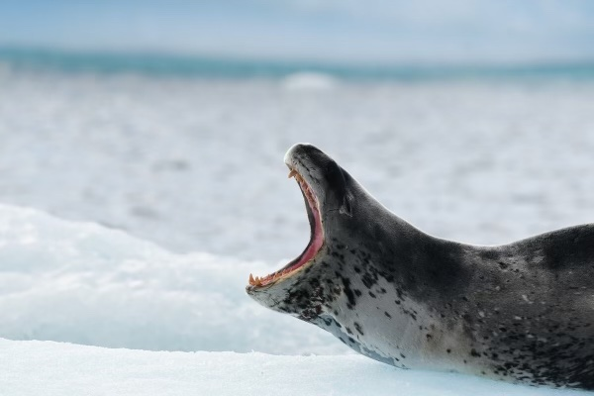
Next Sprint
Train and evaluate ViT
Preprocess pictures after detection model
Notes:
Carsyn
Next sprint’s focus will be on our second model. We will look into getting ViT working with our data, training it, and evaluating it, similarly to how we trained and evaluated YOLO for this sprint. With our competing model working, we will have a baseline for when we create our own model for leopard seal identification. Additionally, we will look into methods for preprocessing the images before feeding them into the second model, as we only need the seal and not the rest of the surrounding background. With these cropped images, we will be able to give our model only the necessary data needed to identify the specific seal.

Slide 13
Questions

